Slide 1
Programming in Java
String and StringBuilder

Slide 2
string
Unlike many other languages that implement strings as character arrays, Java implements strings as objects of type String.
Advantage of creating strings as objects is that String objects can be constructed a number of ways, making it easy to obtain a string when needed.
Once a String object has been created, you cannot change the characters that comprise that string.
You can still perform all types of string operations. The difference is that each time we need an altered version of an existing string, a new String object is created that contains the modifications. The original string is left unchanged.
This approach is used because fixed, immutable strings can be implemented more efficiently than changeable ones.

Slide 3
string
For those cases in which a modifiable string is desired, Java provides two options: StringBuffer and StringBuilder. Both hold strings that can be modified after they are created.
The String, StringBuffer, and StringBuilder classes are defined in java.lang. Thus, they are available to all programs automatically.
The String, StringBuffer, and StringBuilder classes are declared final, which means that none of these classes may be subclassed.

Slide 4
The String Constructors
The String class supports several constructors. To create an empty String, you call the default constructor. For example,
String s = new String();
will create an instance of String with no characters in it.
Frequently, we want to create strings that have initial values. The String class provides a variety of constructors to handle this. To create a String initialized by an array of characters, use the constructor shown here:
String(char chars[ ])
Here is an example:
char chars[] = { 'a', 'b', 'c' };
String s = new String(chars);
This constructor initializes s with the string “abc”.

Slide 5
The String Constructors
We can specify a subrange of a character array as an initializer using the following constructor:
String(char chars[ ], int startIndex, int numChars)
Here, startIndex specifies the index at which the subrange begins, and
numChars specifies the number of characters to use. Here is an example:
char chars[] = { 'a', 'b', 'c', 'd', 'e', 'f' };
String s = new String(chars, 2, 3);

Slide 6
The String Constructors
We can construct a String object that contains the same character sequence as another String object using this constructor:
String(String strObj)
Here, strObj is a String object.
Consider this example:
// Construct one String from another.
class MakeString {
public static void main(String args[]) {
char c[] = {'J', 'a', 'v', 'a'};
String s1 = new String(c);
String s2 = new String(s1);
System.out.println(s1);
System.out.println(s2);
}
}

Slide 7
The String Constructors
Because 8-bit ASCII strings are common, the String class provides constructors that initialize a string when given a byte array. Their forms are shown here:
String(byte asciiChars[ ])
String(byte asciiChars[ ], int startIndex, int numChars)
Here, asciiChars specifies the array of bytes. The second form allows us to specify a
subrange. In each of these constructors, the byte-to-character conversion is done by
using the default character encoding of the platform. The following program illustrates
these constructors:
// Construct string from subset of char array.
class SubStringCons {
public static void main(String args[]) {
byte ascii[] = {65, 66, 67, 68, 69, 70 };
String s1 = new String(ascii);
System.out.println(s1);
String s2 = new String(ascii, 2, 3);
System.out.println(s2);
}
}

Slide 8
The String Constructors
The contents of the array are copied whenever we create a String object from an array. If we modify the contents of the array after we have created the string, the String will be unchanged.

Slide 9
String Length
The length of a string is the number of characters that it contains. To obtain this value, call the length( ) method, shown here:
int length( )
The following fragment prints “3”, since there are three characters in the string s:
char chars[] = { 'a', 'b', 'c' };
String s = new String(chars);
System.out.println(s.length());

Slide 10
String Literals
The earlier examples showed how to explicitly create a String instance from an array of characters by using the new operator. However, there is an easier way to do this using a string literal.
For each string literal in your program, Java automatically constructs a String object. Thus, you can use a string literal to initialize a String object. For example, the following code fragment creates two equivalent strings:
char chars[] = { 'a', 'b', 'c' };
String s1 = new String(chars);
String s2 = "abc"; // use string literal
It calls the length( ) method on the string “abc”. As expected, it prints “3”.
System.out.println("abc".length());

Slide 11
String Concatenation
Java does not allow operators to be applied to String objects. The one exception to this rule is the + operator, which concatenates two strings, producing a String object as the result.
String age = "9";
String s = "He is " + age + " years old.";
System.out.println(s);
String Concatenation with Other Data Types
int age = 9;
String s = "He is " + age + " years old.";
System.out.println(s);
String s = "four: " + 2 + 2;
System.out.println(s);

Slide 12
Interned Strings
Since strings are immutable and are frequently used, to improve efficiency and save memory, the JVM uses a unique instance for string literals with the same character sequence. Such an instance is called interned. For example, the following statements:

Slide 13
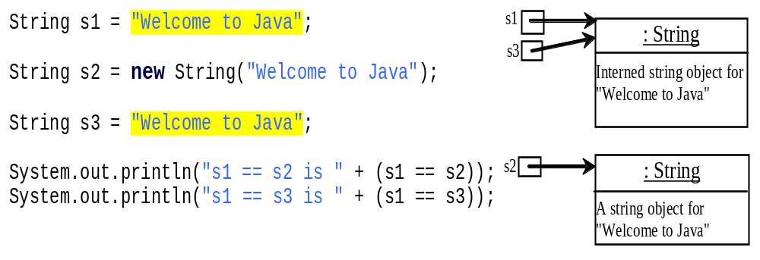
Examples
A new object is created if you use the new operator.
If you use the string initializer, no new object is created if the interned object is already created.

Slide 14
Character Extraction
charAt( )
To extract a single character from a String, you can refer directly to an individual character via the charAt( ) method. It has this general form:
char charAt(int where)
Here, where is the index of the character that you want to obtain. The value of here must be nonnegative and specify a location within the string. charAt( ) returns the character at the specified location. For example,
char ch;
ch = "abc".charAt(1);
assigns the value “b” to ch.

Slide 15
Character Extraction
getChars( )
If you need to extract more than one character at a time, you can use the getChars( ) method. It has this general form:
void getChars(int sourceStart, int sourceEnd, char target[ ], int targetStart)
class getCharsDemo {
public static void main(String args[]) {
String s = "This is a demo of the getChars method.";
int start = 10;
int end = 14;
char buf[] = new char[end - start];
s.getChars(start, end, buf, 0);
System.out.println(buf);
}
}

Slide 16
Character Extraction
getBytes( )
getBytes( ) uses the default character-to-byte conversions provided by the platform. Here is its simplest form:
byte[ ] getBytes( )
getBytes( ) is most useful when you are exporting a String value into an environment that does not support 16-bit Unicode characters. For example, most Internet protocols and text file formats use 8-bit ASCII for all text interchange.
toCharArray( )
If you want to convert all the characters in a String object into a character array, the easiest way is to call toCharArray( ). It returns an array of characters for the entire string. Its general form is:
char[ ] toCharArray( )
This function is provided as a convenience, since it is possible to use getChars( ) to achieve the same result.

Slide 17
Byte Extraction
class TestingByteArrayCharArray
{
public static void main(String[] args)
{
String a=new String();
a="testing get bytes";
byte charArray[]=new byte[a.length()];
charArray=a.getBytes();
for(byte i: charArray)
{
System.out.println(i);
}
}
}

Slide 18
class TestingByteArrayCharArray
{
public static void main(String[] args)
{
String a=new String();
a="testing get bytes";
byte byteArray[]=new byte[a.length()];
byteArray=a.getBytes();
for(byte i: byteArray)
{
System.out.println(i);
}
//System.out.println(a[5]);
char charArray[]=new char[a.length()];
charArray=a.toCharArray();
for(int i=0; i<a.length(); i++)
{
System.out.println(charArray[i]);
}
}
}

Slide 19
Conversion between Strings and Arrays
Strings are not arrays, but a string can be converted into an array, and vice versa. To convert a string to an array of characters, use the toCharArray() or getChars(int sourceStart, int sourceEnd, char target[ ], int targetStart) methods as discussed.
To convert an array of characters into a string, use the String(char[]) constructor or the static valueOf(char[]) method.
For example, the following statement constructs a string from an array using the String constructor.
String str = new String(new char[]{'J', 'a', 'v', 'a'});
The next statement constructs a string from an array using the valueOf() method.
String str = String.valueOf(new char[]{'J', 'a', 'v', 'a'});

Slide 20
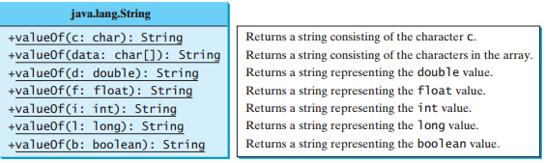
Converting Characters and Numeric Values to Strings
The static valueOf method can be used to convert an array of characters into a string. There are several overloaded versions of the valueOf method

Slide 21
String Comparison
The String class includes a number of methods that compare strings or substrings within strings. Several are examined here. equals( ) and equalsIgnoreCase( )
boolean equals(Object str)
boolean equalsIgnoreCase(String str)
// Demonstrate equals() and equalsIgnoreCase().
class equalsDemo {
public static void main(String args[]) {
String s1 = "Hello";
String s2 = "Hello";
String s3 = "Good-bye";
String s4 = "HELLO";
System.out.println(s1 + " equals " + s2 + " -> " +s1.equals(s2));
System.out.println(s1 + " equals " + s3 + " -> " +s1.equals(s3));
System.out.println(s1 + " equals " + s4 + " -> " +s1.equals(s4));
System.out.println(s1 + " equalsIgnoreCase " + s4 + " -> " +
s1.equalsIgnoreCase(s4));
}
}

Slide 22
startsWith( ) and endsWith( )
boolean startsWith(String str)
boolean endsWith(String str)
Here, str is the String being tested. If the string matches, true is returned. Otherwise, false is returned. For example,
“student".endsWith(“dent")
and
“smith”.startsWith(“smi")
boolean startsWith(String str, int startIndex)
Here, startIndex specifies the index into the invoking string at which point the search will begin. For example, “Student".startsWith(“dent”, 3) returns true.

Slide 23
equals( ) Versus ==
// equals() vs ==
class EqualsNotEqualTo {
public static void main(String args[]) {
String s1 = "Hello";
String s2 = new String(s1);
System.out.println(s1 + " equals " + s2 + " -> " +s1.equals(s2));
System.out.println(s1 + " == " + s2 + " -> " + (s1 == s2));
}
}
The equals( ) method compares the characters inside a String object.
The == operator compares two object references to see whether they refer
to the same instance.

Slide 24
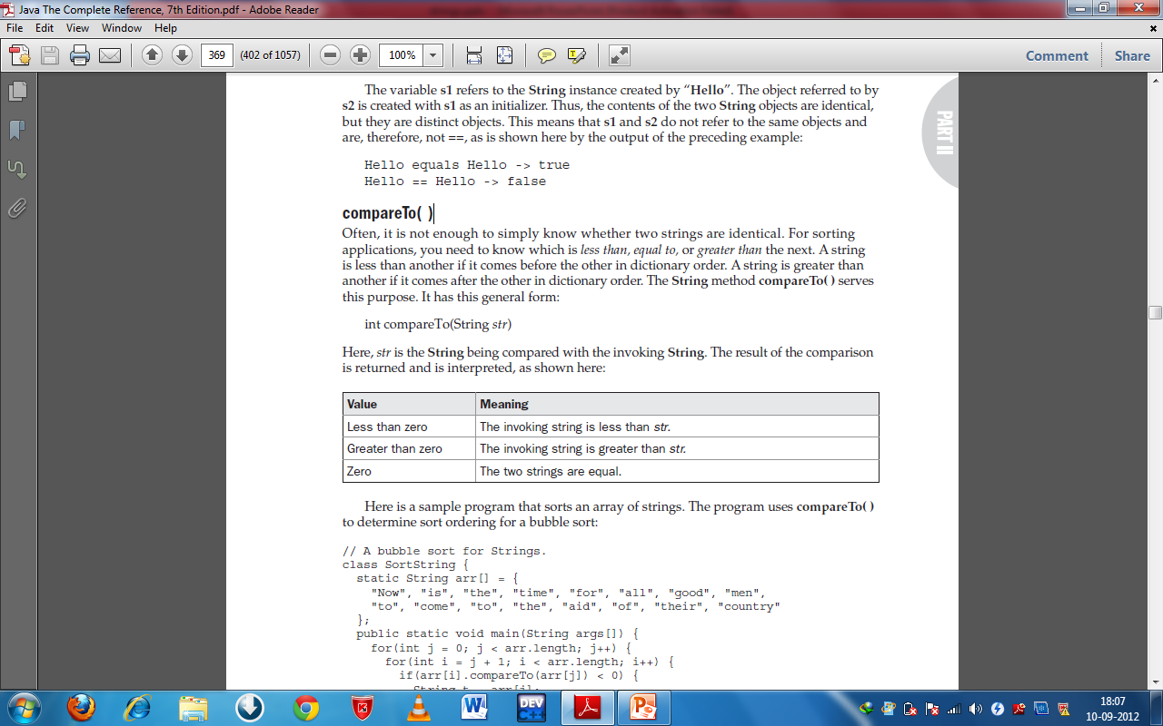
compareTo( )
For sorting applications, we need to know which is less than, equal to, or greater than the next. A string is less than another if it comes before the other in dictionary order. A string is greater than another if it comes after the other in dictionary order. The String method compareTo( ) serves this purpose. It has this general form:
int compareTo(String str)

Slide 25
compareTo( )
class SortString {
static String arr[] = {"Now", "is", "the", "time", "for", "all", "good","men", "to", "come", "to", "the", "aid", "of", "their", "country"};
public static void main(String args[])
{
for(int i = 0; i < arr.length; i++)
{
for(int j = i+ 1; j < arr.length; j++)
{
if(arr[i].compareTo(arr[j]) > 0)
{
String t = arr[j];
arr[j] = arr[i];
arr[i] = t;
}
}
System.out.println(arr[i]);
}
}
}

Slide 26
compareTo( )
compareTo( ) takes into account uppercase and lowercase letters. The word “Now” came out before all the others because it begins with an uppercase letter, which means it has a lower value in the ASCII character set.
If we want to ignore case differences when comparing two strings, use
compareToIgnoreCase( ), as shown here:
int compareToIgnoreCase(String str)
Syntax errors will occur if you compare strings by using comparison operators, such as >, >=, <, or <=. Instead, you have to use s1.compareTo(s2)

Slide 27
Searching Strings
The String class provides two methods that allow you to search a string for a specified character or substring:
The String class provides two methods that allow you to search a string for a specified character or substring:
indexOf( ) Searches for the first occurrence of a character or substring.
lastIndexOf( ) Searches for the last occurrence of a character or substring.

Slide 28
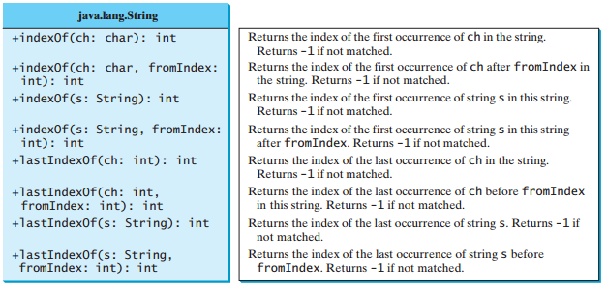
Searching Strings

Slide 29
Searching Strings
// Demonstrate indexOf() and lastIndexOf().
class indexOfDemo {
public static void main(String args[]) {
String s = "Now is the time for all good men " + "to come to the aid of their country.";
System.out.println(s);
System.out.println("indexOf(t) = " +s.indexOf('t'));
System.out.println("lastIndexOf(t) = " +s.lastIndexOf('t'));
System.out.println("indexOf(the) = " +s.indexOf("the"));
System.out.println("lastIndexOf(the) = " +s.lastIndexOf("the"));
System.out.println("indexOf(t, 10) = " +s.indexOf('t', 10));
System.out.println("lastIndexOf(t, 60) = " +s.lastIndexOf('t', 60));
System.out.println("indexOf(the, 10) = " +s.indexOf("the", 10));
System.out.println("lastIndexOf(the, 60) = " + s.lastIndexOf("the", 60));
}
}

Slide 30
Searching Strings
indexOf(t) = 7
lastIndexOf(t) = 65
indexOf(the) = 7
lastIndexOf(the) = 55
indexOf(t, 10) = 11
lastIndexOf(t, 60) = 55
indexOf(the, 10) = 44
lastIndexOf(the, 60) = 55

Slide 31
Modifying a String
Because String objects are immutable, whenever we want to modify a String, you must either copy it into a StringBuffer or StringBuilder, or use one of the following String methods, which will construct a new copy of the string with your modifications complete.
substring( )
You can extract a substring using substring( ). It has two forms.
The first is String substring(int startIndex). Here, startIndex specifies the index at which the substring will begin. This form returns a copy of the substring that begins at startIndex and runs to the end of the invoking string.
The second form of substring( ) allows us to specify both the beginning and ending index of the substring:
String substring(int startIndex, int endIndex)
Here, startIndex specifies the beginning index, and endIndex specifies the stopping point. The string returned contains all the characters from the beginning index, up to, but not including, the ending index.

Slide 32
Modifying a String
// Substring replacement.
class StringReplace {
public static void main(String args[]) {
String org = "This is a test. This is, too.";
String search = "is";
String sub = "was";
String result = "";
int i;
do { // replace all matching substrings
System.out.println(org);
i = org.indexOf(search);
if(i != -1) {
result = org.substring(0, i);
result = result + sub;
result = result + org.substring(i + search.length());
org = result;
}
} while(i != -1);
}
}

Slide 33
concat
We can concatenate two strings using concat( ), shown here:
String concat(String str)
This method creates a new object that contains the invoking string with the contents of str appended to the end. concat( ) performs the same function as +. For example,
String s1 = "one";
String s2 = s1.concat("two");
puts the string “onetwo” into s2. It generates the same result as the following sequence:
String s1 = "one";
String s2 = s1 + "two";

Slide 34
replace( )
The replace( ) method has two forms. The first replaces all occurrences of one character in the invoking string with another character. It has the following general form:
String replace(char original, char replacement)
Here, original specifies the character to be replaced by the character specified by replacement. The resulting string is returned. For example,
String s = "Hello".replace('l', 'w');
puts the string “Hewwo” into s. The second form of replace( ) replaces one character sequence with another. It has this general form:
String replace(CharSequence original, CharSequence replacement)

Slide 35
trim( )
The trim( ) method returns a copy of the invoking string from which any leading and trailing whitespace has been removed. It has this general form:
String trim( )
Here is an example:
String s = " Hello World ".trim();
This puts the string “Hello World” into s.
The trim( ) method is quite useful when you process user commands.

Slide 36
Changing the Case of Characters Within a String
String toLowerCase( )
String toUpperCase( )
// Demonstrate toUpperCase() and toLowerCase().
class ChangeCase {
public static void main(String args[])
{
String s = "This is a test.";
System.out.println("Original: " + s);
String upper = s.toUpperCase();
String lower = s.toLowerCase();
System.out.println("Uppercase: " + upper);
System.out.println("Lowercase: " + lower);
}
}

Slide 37
Variable-Length Argument List
You can pass a variable number of arguments of the same type to a method. The parameter in the method is declared as follows:
typeName... parameterName
In the method declaration, you specify the type followed by an ellipsis Only one variable-length parameter may be specified in a method, and this parameter must be the last parameter. Any regular parameters must precede it
Java treats a variable-length parameter as an array. You can pass an array or a variable number of arguments to a variable-length parameter

Slide 38
class VarArgsDemo
{
public static void main(String[] args)
{
printMax(34, 3, 3, 2, 56.5);
printMax(new double[]{1, 2, 3});
}
public static void printMax(double ... numbers)
{
if (numbers.length == 0)
{
System.out.println("No argument passed");
return;
}
double result = numbers[0];
for (int i = 1; i < numbers.length; i++)
if (numbers[i] > result)
result = numbers[i];
System.out.println("The max value is " + result);
}
}

Slide 39
Java String join
The java string join() method returns a string joined with given delimiter. In string join method, delimiter is copied for each elements.
In case of null element, "null" is added. The join() method is included in java string since JDK 1.8.
public static String join(CharSequence delimiter, CharSequence... elements)
Parameters
  delimiter : char value to be added with each element
  elements : char value to be attached with delimiter
Returns
  joined string with delimiter

Slide 40
Java String join
// Demonstrate the join() method defined by String.
class StringJoinDemo
{
public static void main(String args[])
{
String result = String.join(" ", "Alpha", "Beta", "Gamma");
System.out.println(result);
result = String.join(", ", "John", "ID#: 569","E-mail: John@HerbSchildt.com");
System.out.println(result);
}
}
The output is shown here:
Alpha Beta Gamma
John, ID#: 569, E-mail: John@HerbSchildt.com

Slide 41
Java String intern
The java string intern() method returns the interned string. It returns the canonical representation of string.
It can be used to return string from pool memory, if it is created by new keyword.
Signature
The signature of intern method is given below:
public String intern()
Returns
interned string

Slide 42
Java String intern
public class InternExample
{
public static void main(String args[])
{
String s1=new String("hello");
String s2="hello";
String s3=s1.intern();//returns string from pool, now it will be same as s2
System.out.println(s1==s2);//false because reference is different
System.out.println(s2==s3);//true because reference is same
}}
Output:
  false
  true

Slide 43
StringBuilder
public final class StringBuilder extends Object implements Serializable, CharSequence
A mutable sequence of characters. This class provides an API compatible with StringBuffer, but with no guarantee of synchronization. This class is designed for use as a drop-in replacement for StringBuffer in places where the string buffer was being used by a single thread (as is generally the case).
Where possible, it is recommended that this class be used in preference to StringBuffer as it will be faster under most implementations.
The principal operations on a StringBuilder are the append and insert methods, which are overloaded so as to accept data of any type. Each effectively converts a given datum to a string and then appends or inserts the characters of that string to the string builder.
The append method always adds these characters at the end of the builder; the insert method adds the characters at a specified point.

Slide 44
Constructors
StringBuilder()
Constructs a string builder with no characters in it and an initial capacity of 16 characters.
StringBuilder(CharSequence seq)
Constructs a string builder that contains the same characters as the specified CharSequence.
StringBuilder(int capacity)
Constructs a string builder with no characters in it and an initial capacity specified by the capacity argument.
StringBuilder(String str)
Constructs a string builder initialized to the contents of the specified string.

Slide 45
Methods
public StringBuilder append(String s)
is used to append the specified string with this string. The append() method is overloaded like append(char), append(boolean), append(int), append(float), append(double) etc.
public StringBuilder insert(int offset, String s)
is used to insert the specified string with this string at the specified position. The insert() method is overloaded like insert(int, char), insert(int, boolean), insert(int, int), insert(int, float), insert(int, double) etc.
public StringBuilder replace(int startIndex, int endIndex, String str)
is used to replace the string from specified startIndex and endIndex.
public StringBuilder delete(int startIndex, int endIndex)
is used to delete the string from specified startIndex and endIndex.
public StringBuilder reverse()
is used to reverse the string.
public int capacity()
is used to return the current capacity.

Slide 46
Methods
public void ensureCapacity(int minimumCapacity)
is used to ensure the capacity at least equal to the given minimum.
public char charAt(int index)
is used to return the character at the specified position.
public int length()
is used to return the length of the string i.e. total number of characters.
public String substring(int beginIndex)
is used to return the substring from the specified beginIndex.
public String substring(int beginIndex, int endIndex)
is used to return the substring from the specified beginIndex and
endIndex.

Slide 47
class TestStringBuilderMethods
{
public static void main(String[] args)
{
StringBuilder sb1=new StringBuilder();
System.out.println(sb1.length());
System.out.println(sb1.capacity());
StringBuilder sb2=new StringBuilder(25);
System.out.println(sb2.length());
System.out.println(sb2.capacity());
StringBuilder sb3=new StringBuilder("Hello World!!!");
System.out.println(sb3.length());
System.out.println(sb3.capacity());
System.out.println(" "+sb3.append("......."));
StringBuilder sb4=new StringBuilder("Programming Java");
System.out.println(" "+sb4.insert(12,"in "));
System.out.println(" "+sb4);
System.out.println(" "+sb4.delete(12,15));
System.out.println(" "+sb4.reverse());
System.out.println(" "+sb4);
StringBuilder sb5=new StringBuilder("Hello");
System.out.println(" "+sb5.replace(2,3,"www"));
StringBuilder sb6=new StringBuilder("Hello");
System.out.println(" "+sb6.charAt(2));
StringBuilder sb7=new StringBuilder("Hello");
System.out.println(" "+sb7.substring(2));
StringBuilder sb8=new StringBuilder("Hello");
System.out.println(" "+sb8.substring(0,2));
}
}

Slide 48
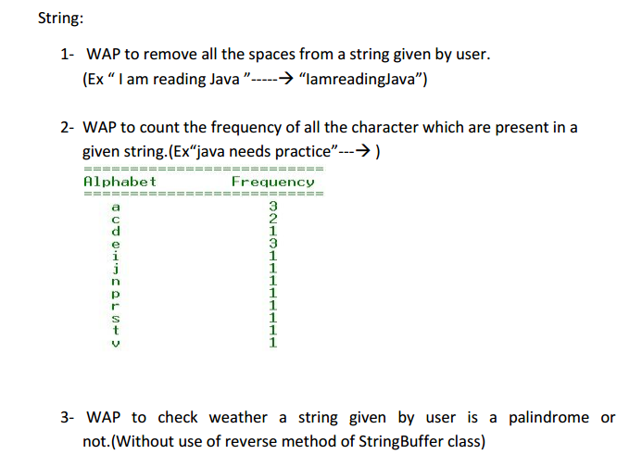
Practice Question

Slide 49
